Slide 1
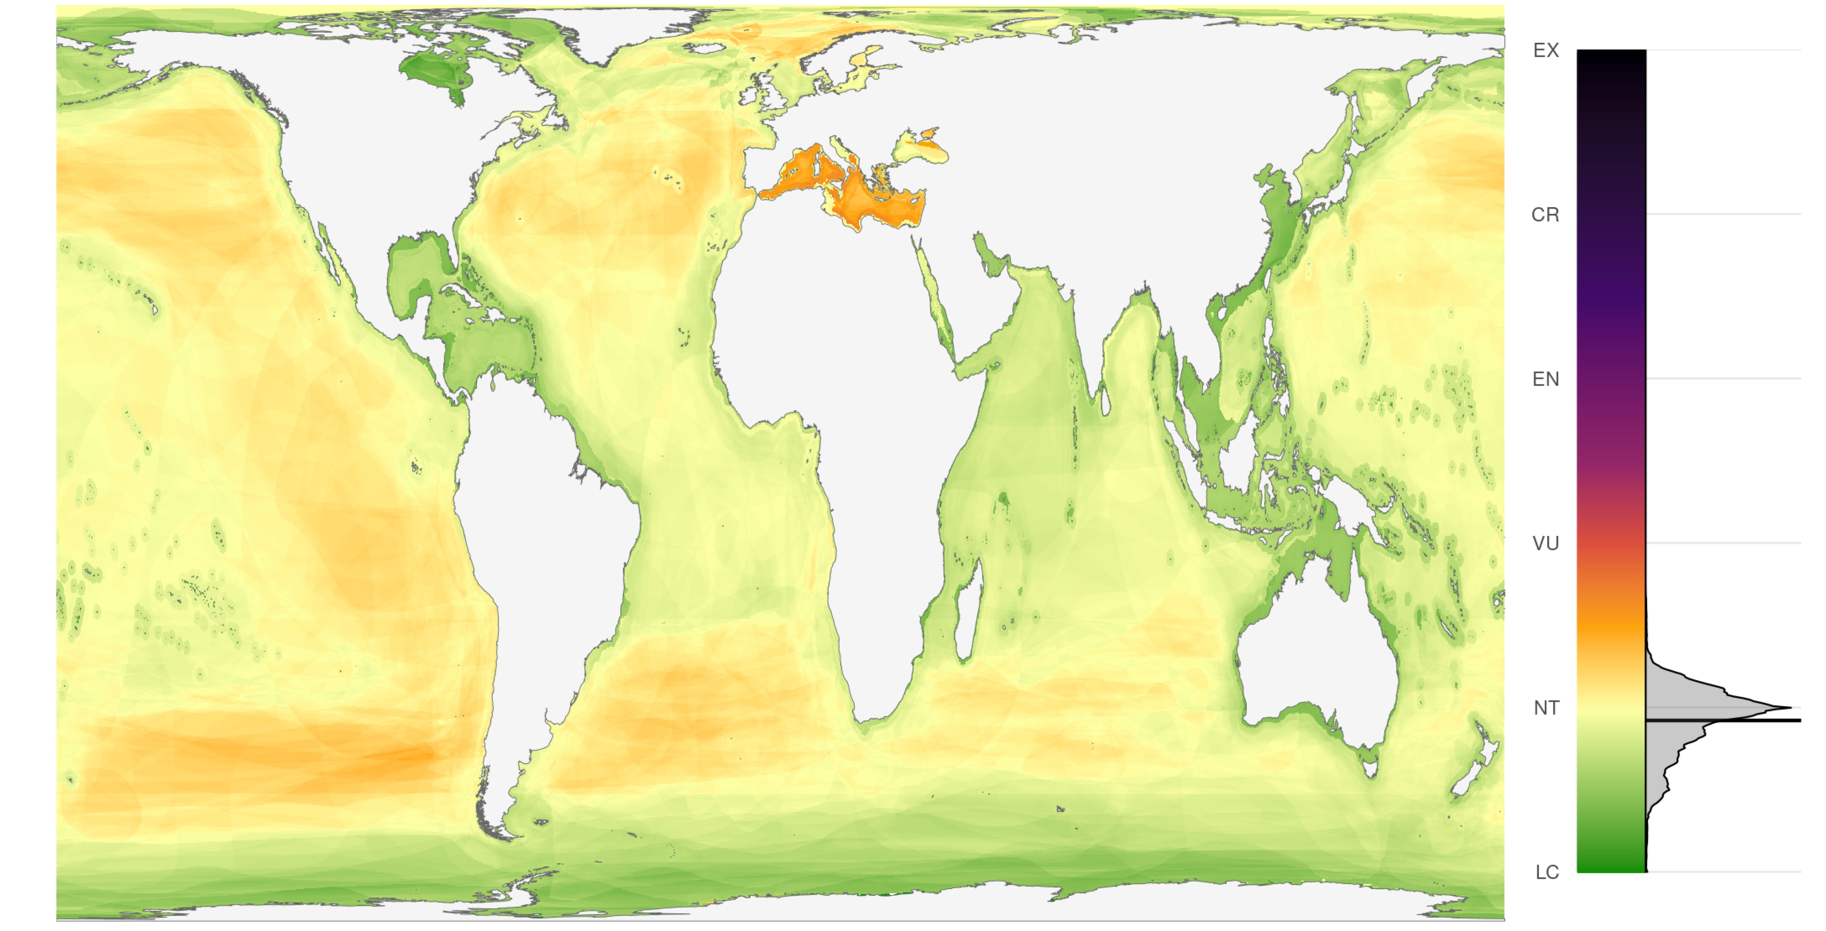
Mapping status and conservation of global at-risk marine biodiversity
Casey C. O’Hara^{1,2}, Juan Carlos Villaseñor-Derbez¹,
Gina M. Ralph³, Benjamin S. Halpern^{1,2}
Bren School of Environmental Science and Management, University of California, Santa Barbara CA 93106
National Center for Ecological Analysis and Synthesis, University of California, 735 State Street Suite 300, Santa Barbara CA 93101
UCN Marine Biodiversity Unit, Department of Biological Sciences, Old Dominion University, Norfolk, VA 23529, USA

Slide 2
Problem statement
Goals to increase protection of marine biodiversity – Aichi and renegotiations in 2020
Prioritization based on richness, abundance
But not on conservation status (i.e. extinction risk – IUCN Red List of Threatened Species)
So we mapped conservation status of 5291 marine species across 25 taxonomic groups
Mammals, corals, turtles, sharks/rays, many fishes, seagrasses, mangroves, some inverts

Slide 3

Global

Slide 4
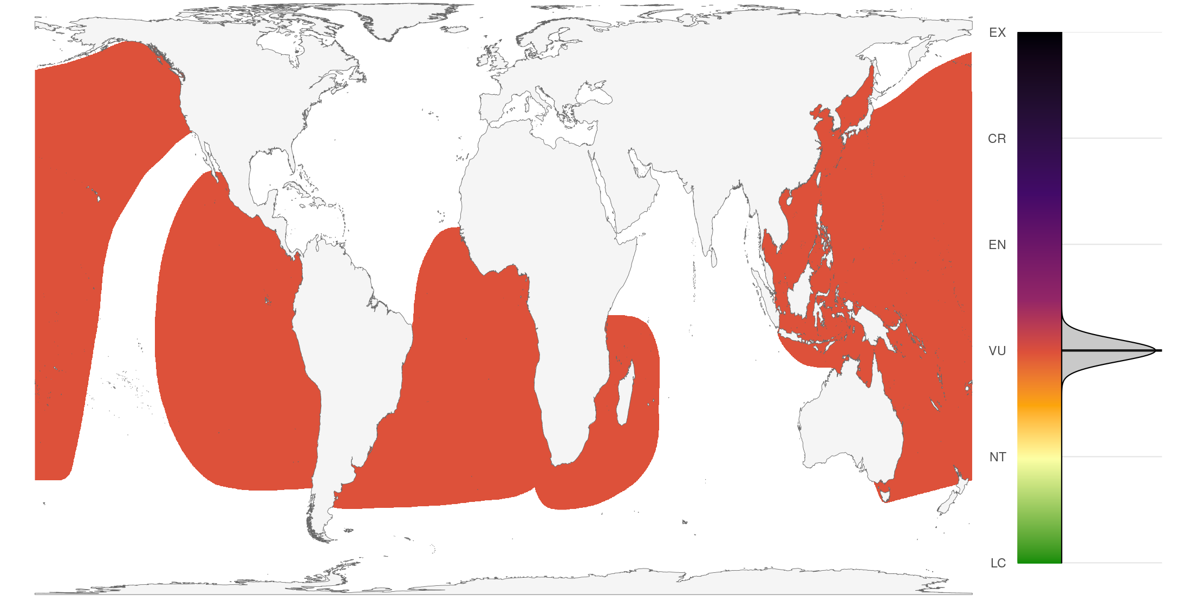
Global score

Slide 5
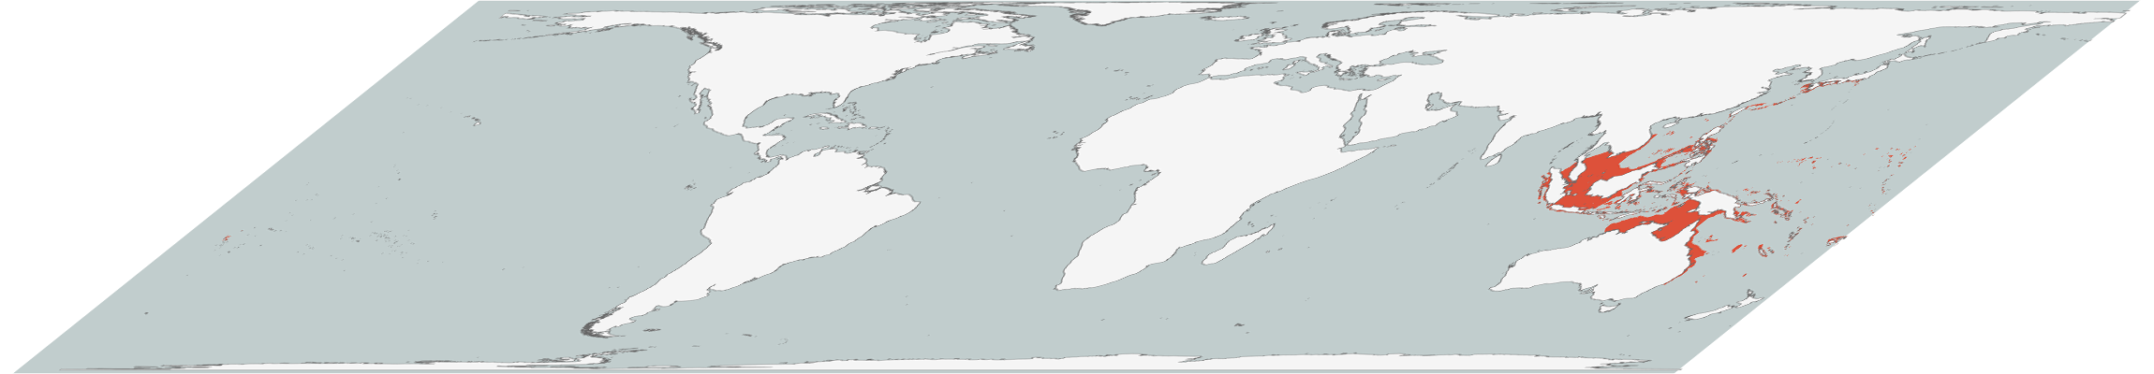
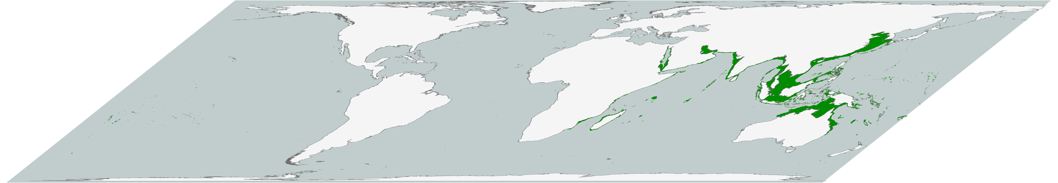
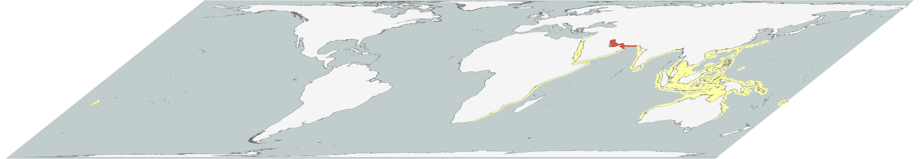
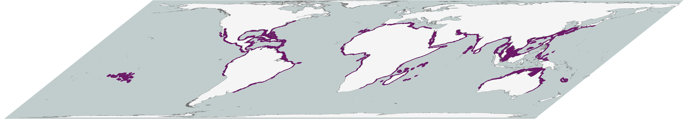
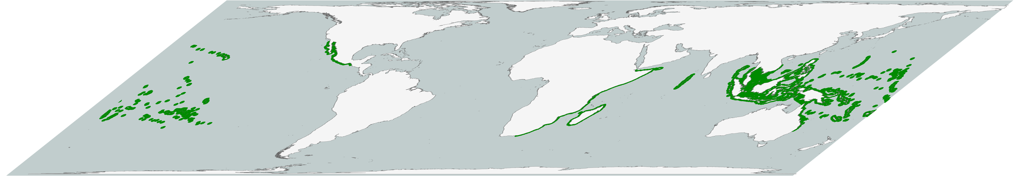
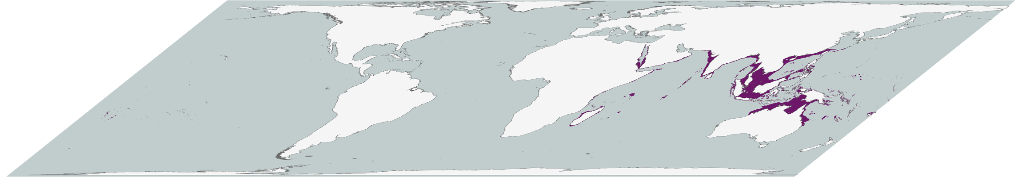
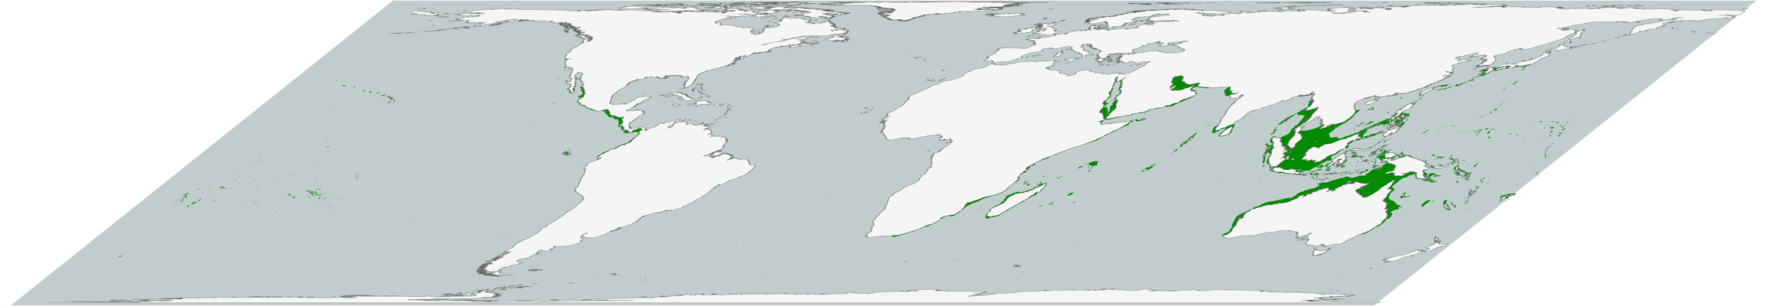
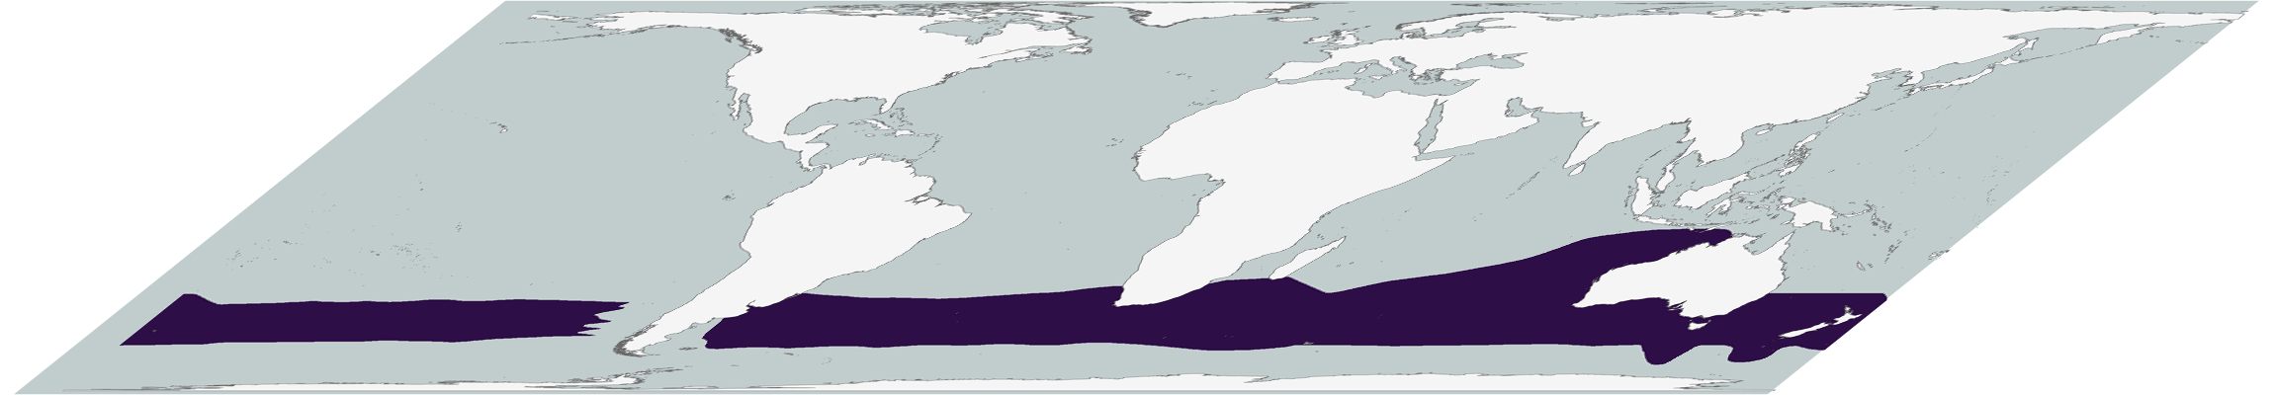
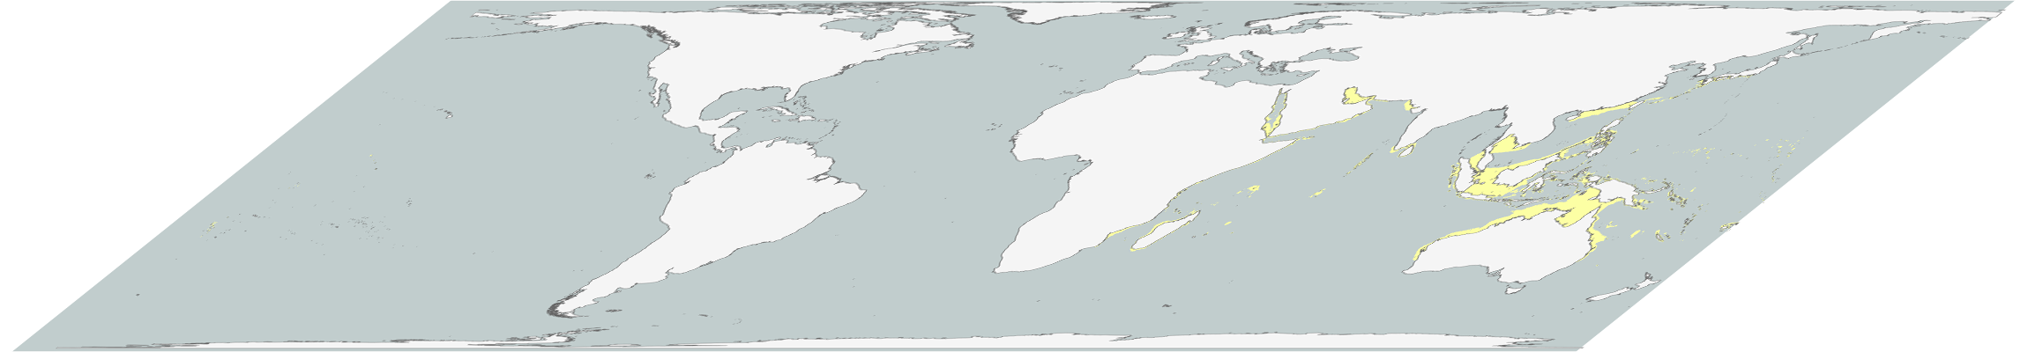


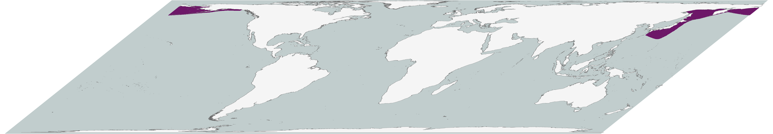
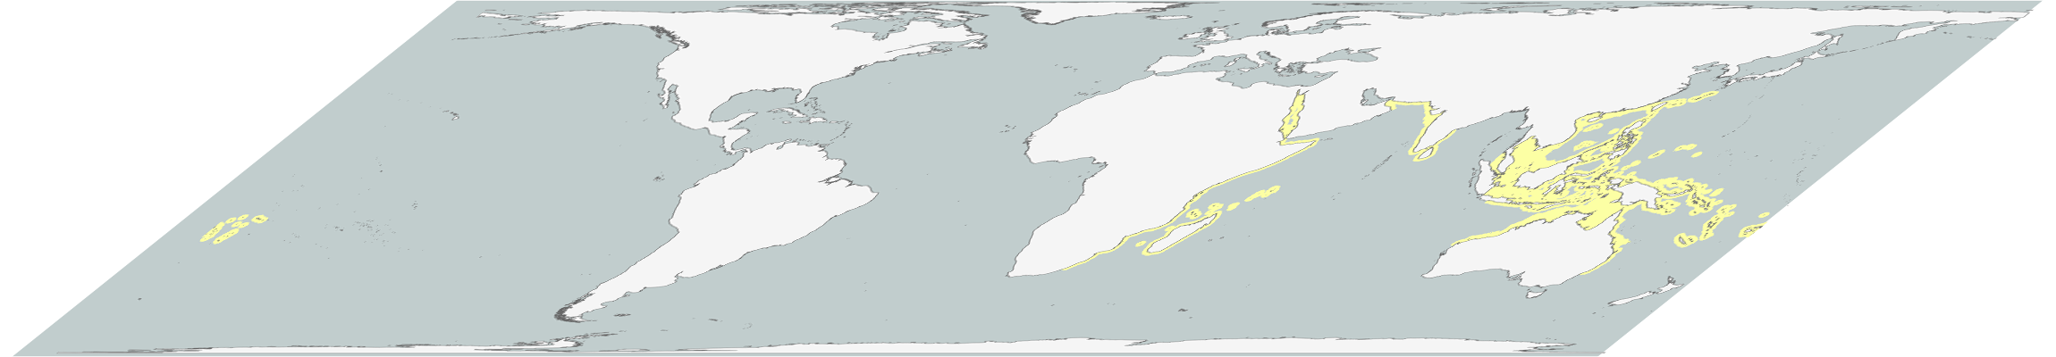
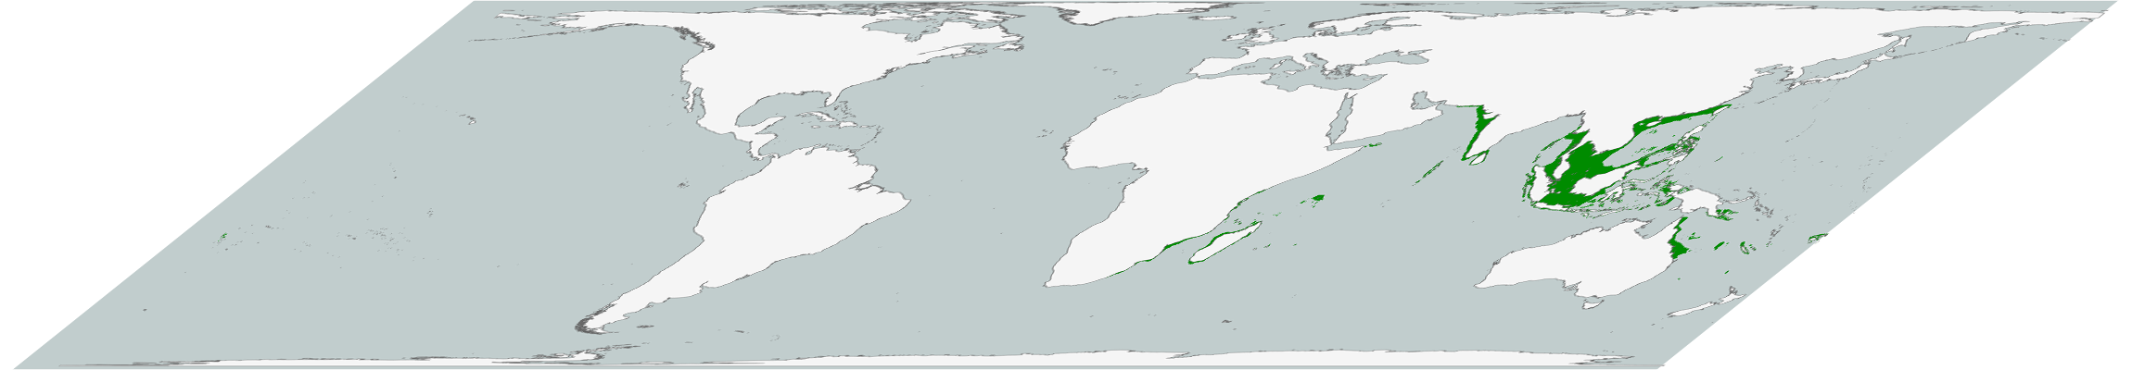
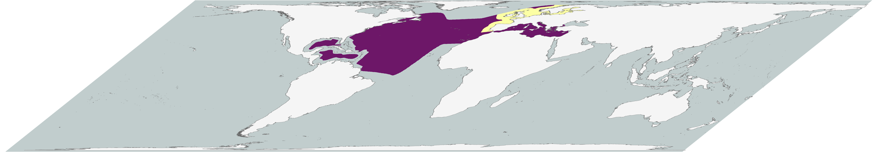
Creating risk maps

Slide 6
Creating risk maps

Slide 7
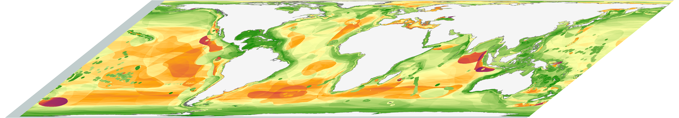
Creating risk maps

Slide 8
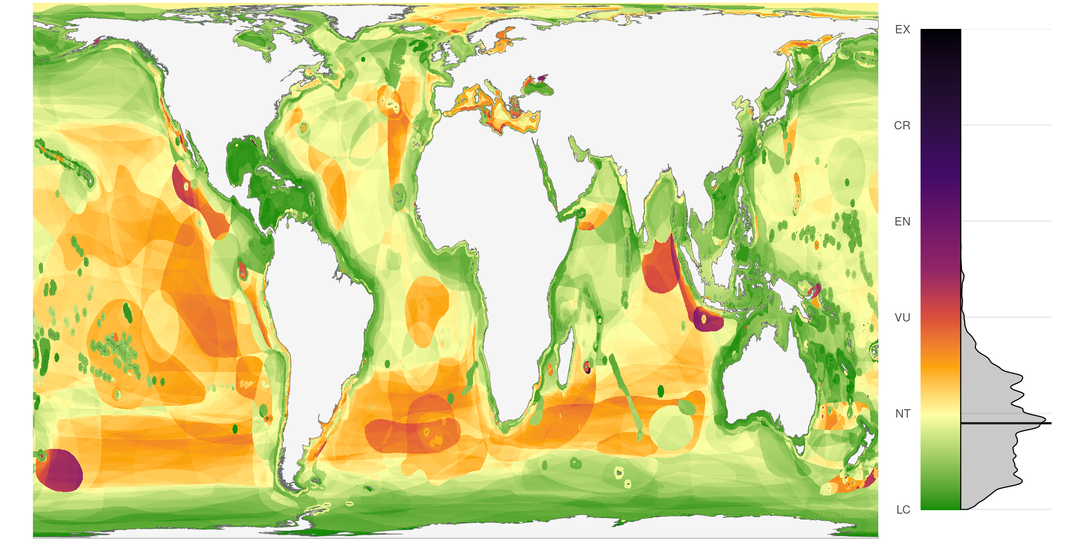
Marine biodiversity risk

Slide 9
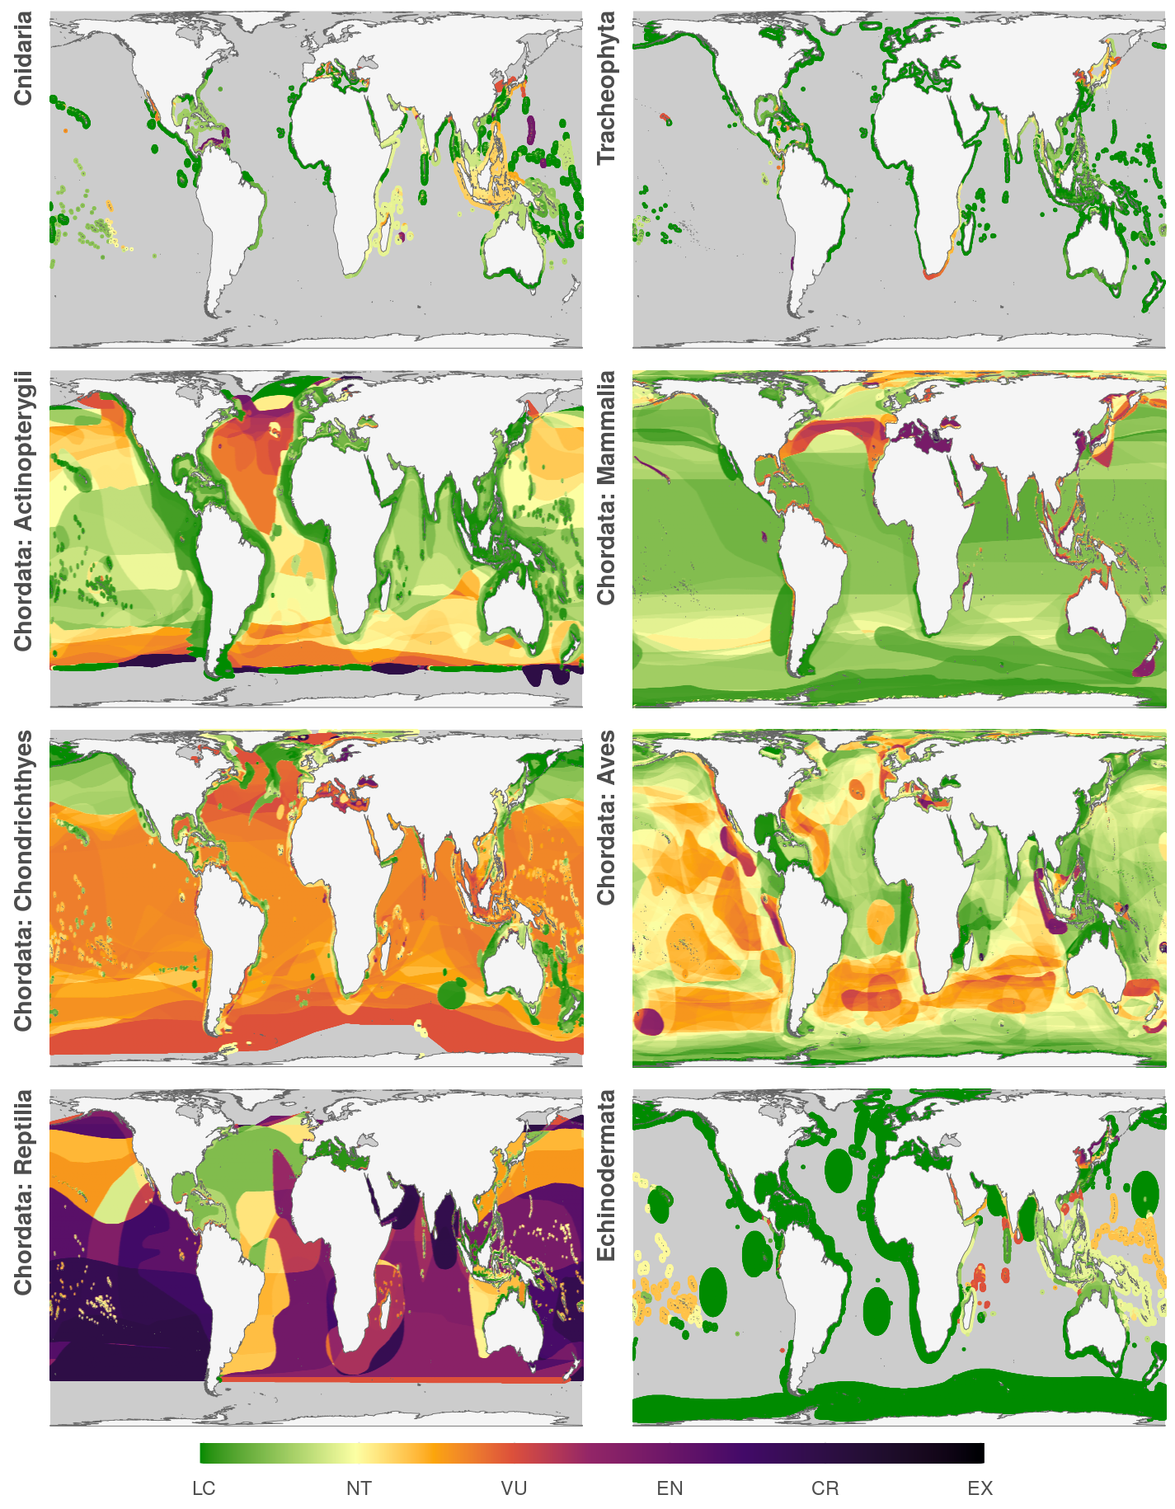

Slide 10
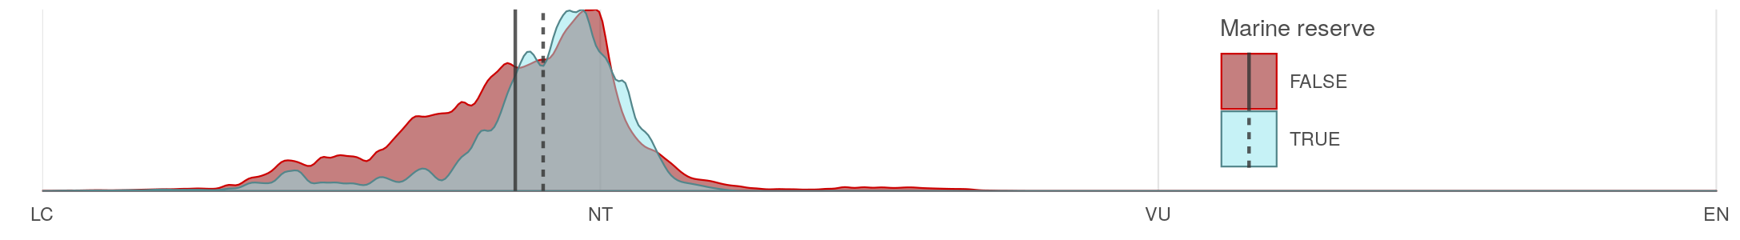
Biodiversity within marine reserves
Global Exclusive Economic Zones (EEZs)
Talk about proactive vs. reactive

Slide 11
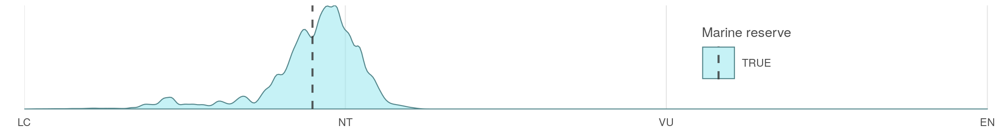
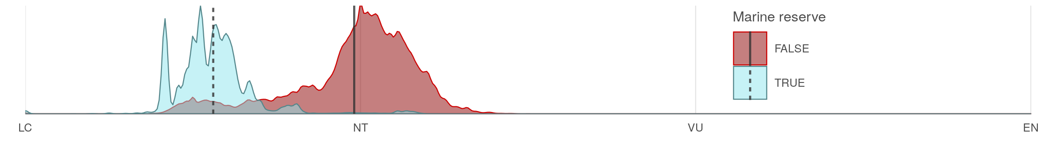
Biodiversity within marine reserves
Global Exclusive Economic Zones (EEZs)
Biodiversity within marine reserves (high seas)

Slide 12
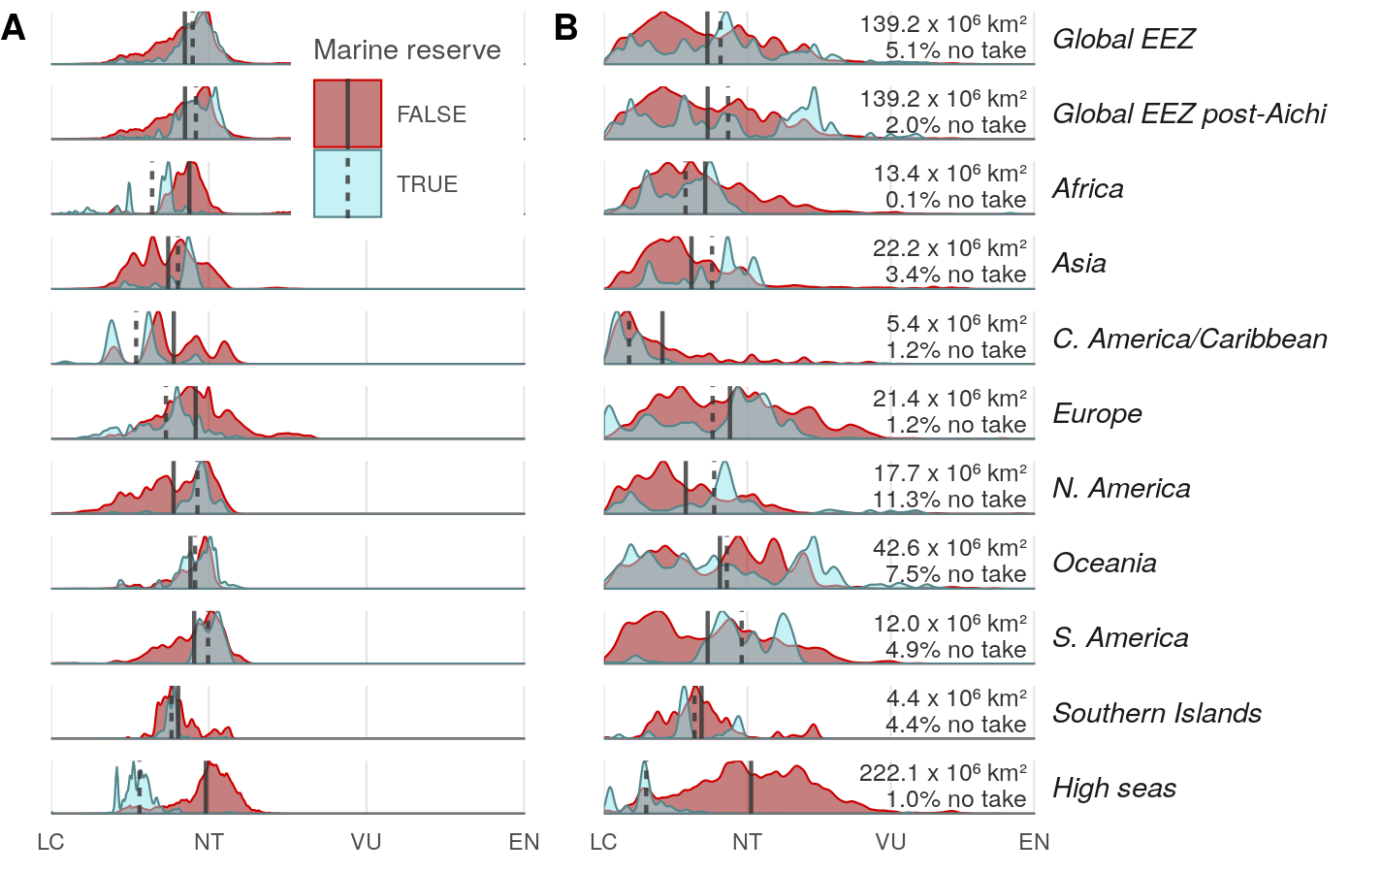
Marine protection by georegion

Slide 13
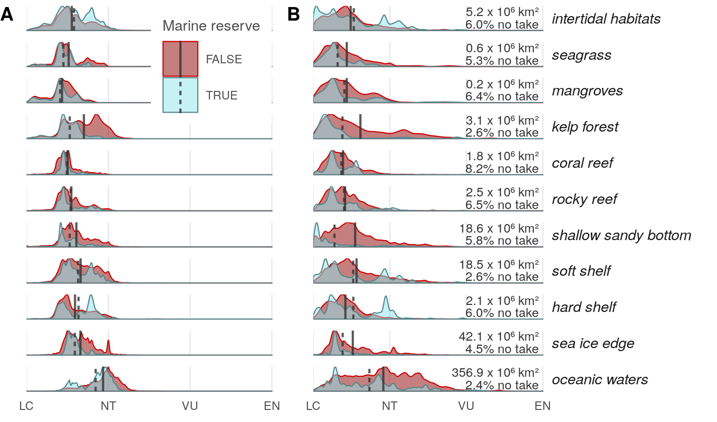
Marine protection by habitat

Slide 14
Next Steps
Biodiversity risk relative to cumulative human impacts

Slide 15
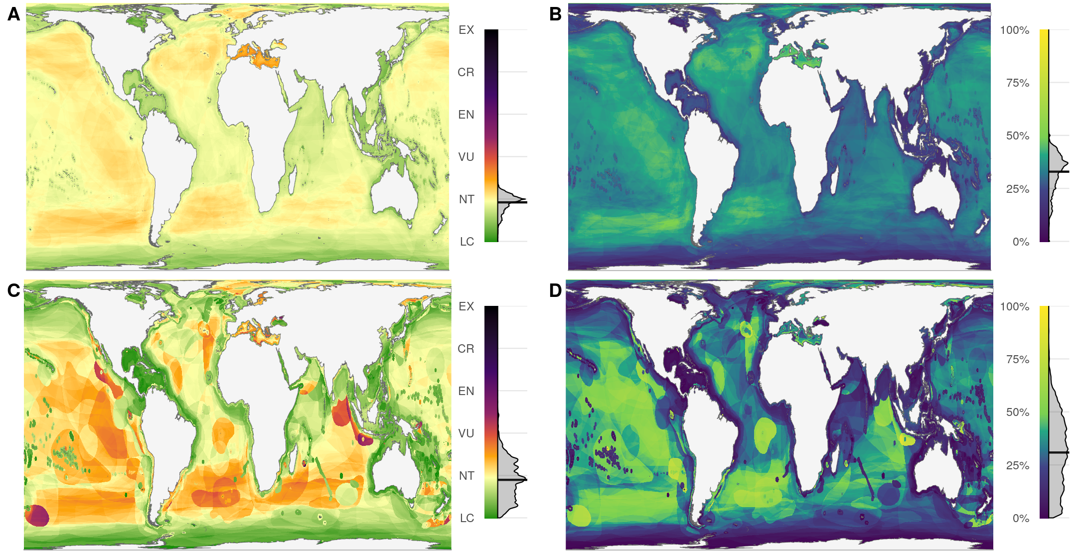
Risk and Percent Threatened

Slide 16
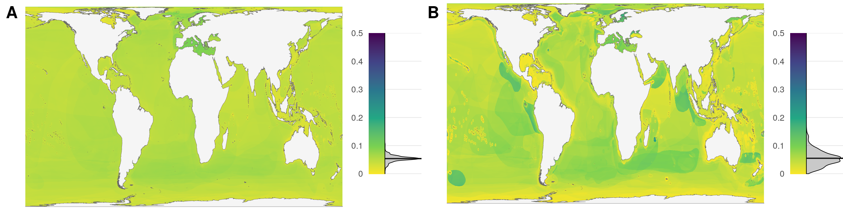
Variance of risk

Slide 17
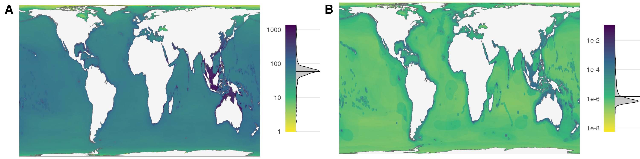
Species richness

